Slide 1
Scrabble Project Presentation & Demo
CA314 - OO Analysis & Design - Group 15

Slide 2
Part One : Analysis
In Part One we focused on the initial design of our scrabble game and began the brainstorming process as a group.
We narrowed down the framework of the game to give a clear and concise path to the next stage of our agile development process.
We decided we would have to evenly distribute work to be done, this included defining requirements, creating the classes and developing CRC cards.
We created the following CRC card based on the player classification.

Slide 3
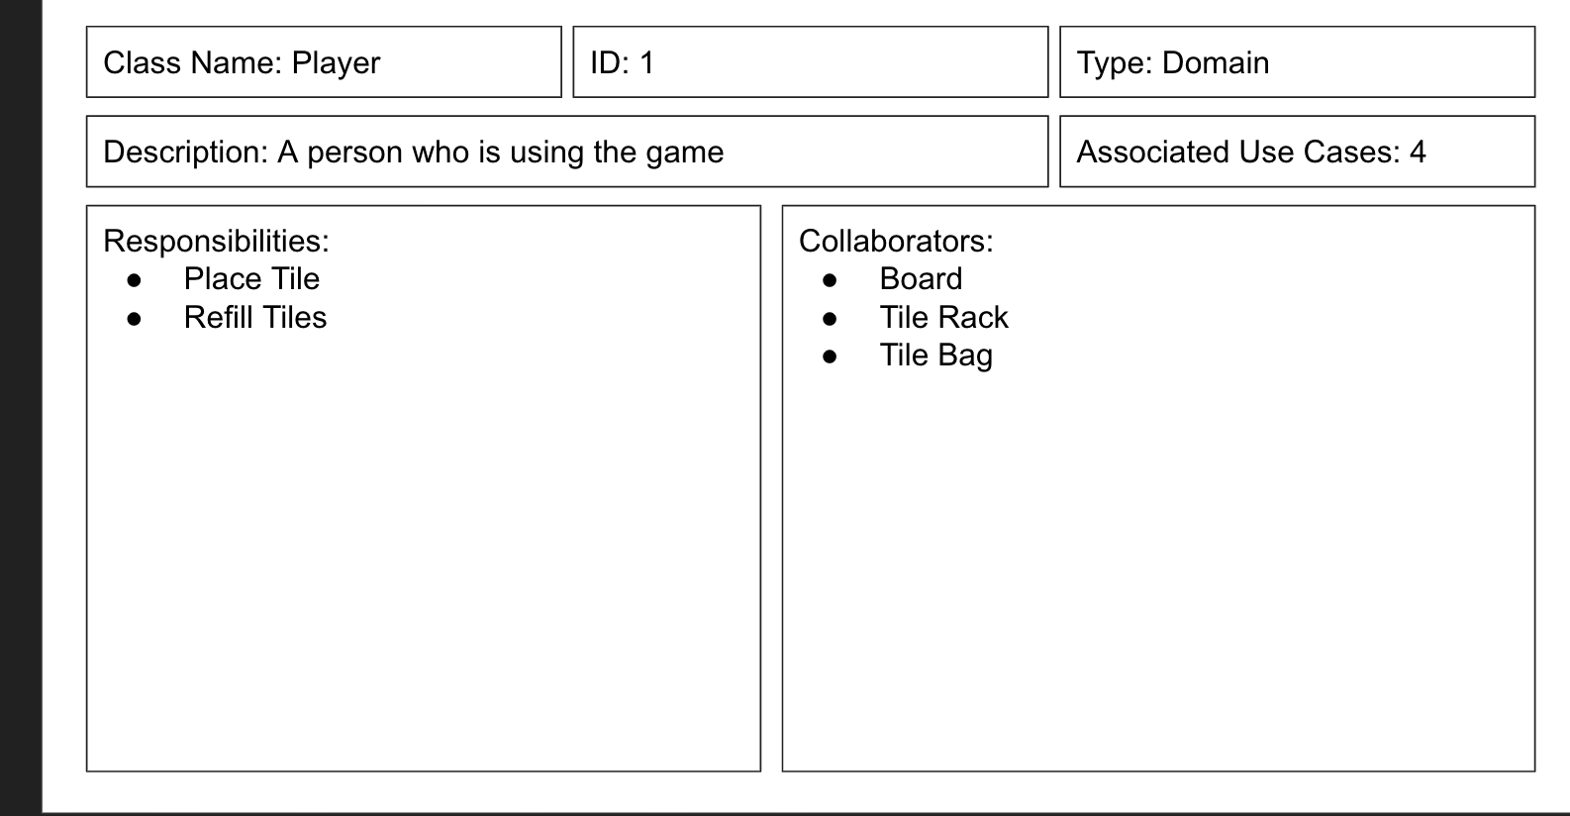
Example: CRC Card of a Player
Notes:
Responsibilities -> methods to the class in our game
Collaborators -> the other class this class interacts with

Slide 4
Lessons Learned in Part 1
While working on Part 1 of this assignment, we learned how to work using an Agile Development Style. This was emphasised in our weekly meetings.
Further understood the importance of iterative development as when we refined one model, we’d have to review others too. (refined requirements - scenarios - diagrams - code)
Abstract skeleton (class diagram) Each step we’ve taken so far was guiding how our code would be written.
Notes:
Our main focus for part 1 was to build a solid foundation for the project and we chose to do this using an agile development style. This involved constantly moving back and forth between testing and developing the code and reviewing and refining our models as shown previously. We benefited from this iterative process as it helped us to make sure all of our diagrams were up to date with any changes we’ve made. This helped us to develop an abstract skeleton of how we expected our code to look as shown in this class diagram which Eimear will discuss.

Slide 5
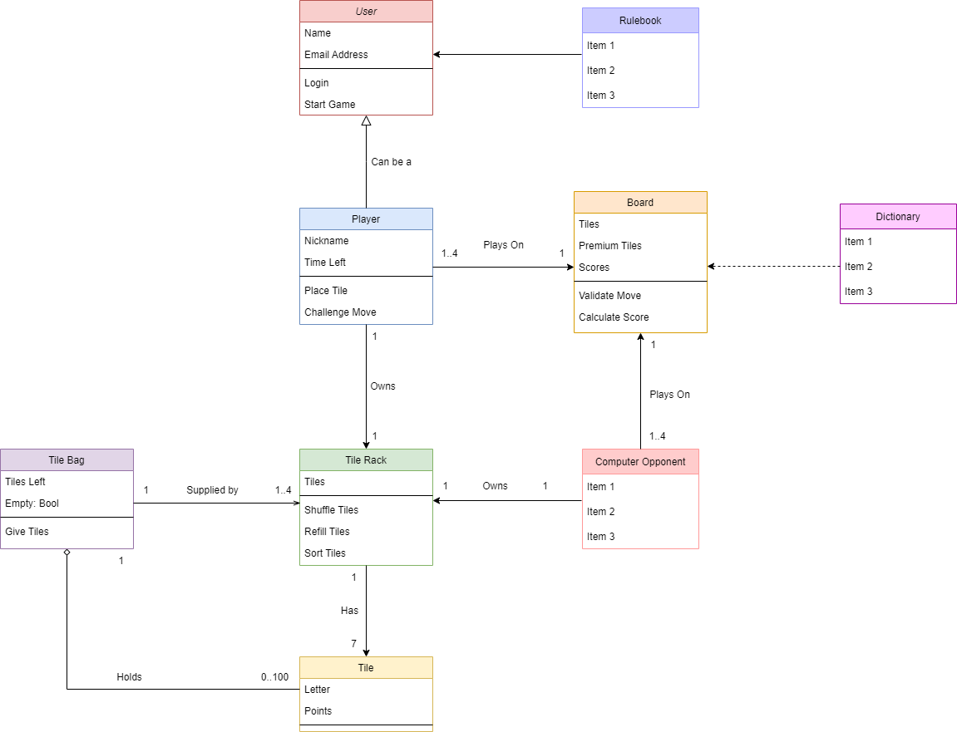
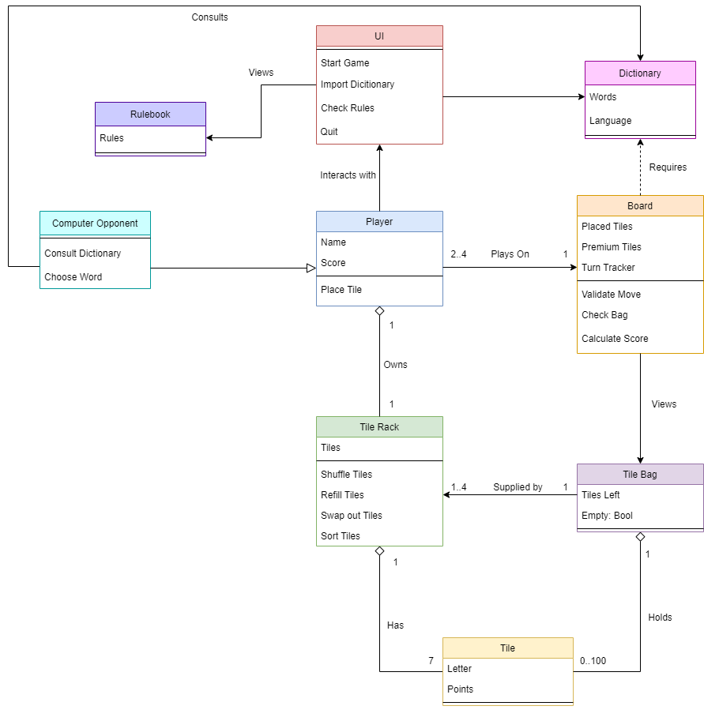
Our First Class Diagrams

Slide 6
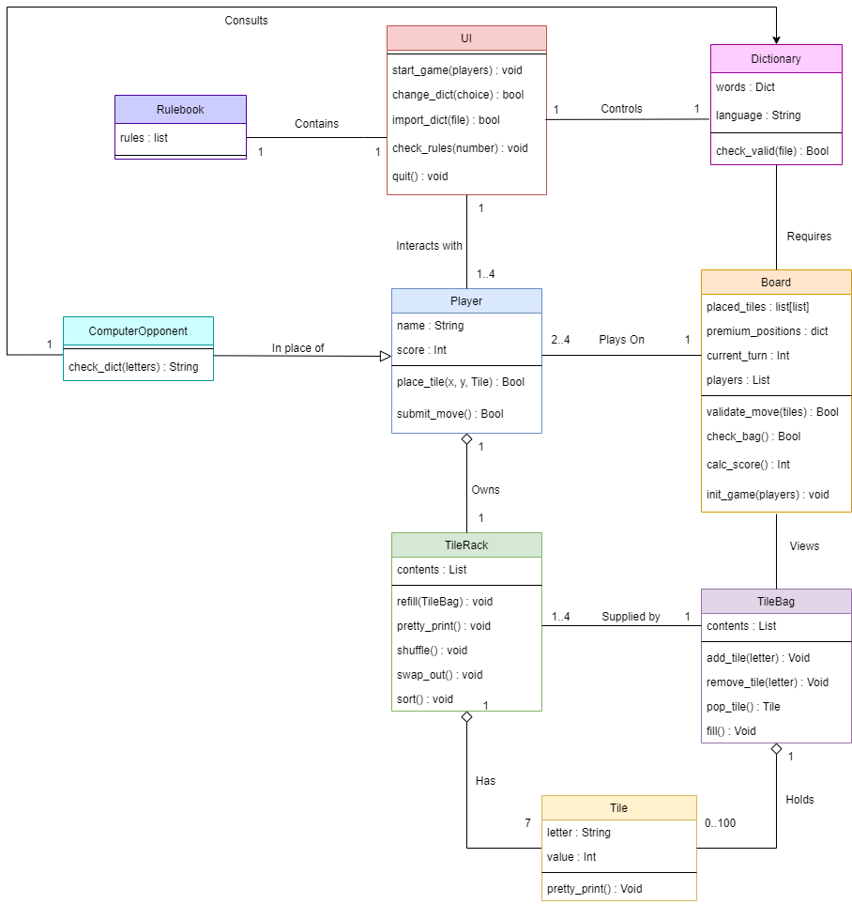
Our Iterated Class Diagram

Slide 7
SECOND SUBMISSION INTRO
For the second submission we focused on the implementation of the game itself, product and class design.
We used diagrams to show how the program would interact with the users and also how the functions within the game would interact with each other.
Diagrams such as communication, sequence and object diagrams were created to show how this would work, We created this communication diagram to show how the game would start:

Slide 8
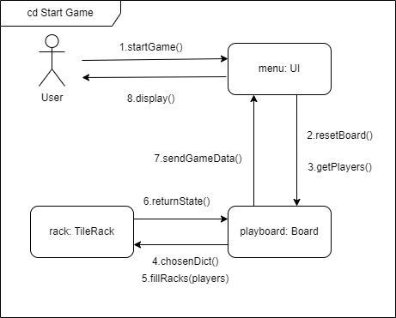
EXAMPLE OF A COMMUNICATION DIAGRAM
Notes:
Here we see how the user interacts with the program and what functions are used to start the game.
It starts with the user communicating with the menu to start the game, we then see the menu interacting with the playboard to reset the board from the previous game and get the players
From there the board interacts with the tilerack with the chosen dictionary and fillRacks functions being used.
Then we see the process of how the information is being sent back and displayed to the users.
The tile rack is sent back to the board which is then sent to the User Interface and displayed for the user to see.

Slide 9
Lessons Learned in Part 2
Goal was to refine the work we did in part 1. We also focused in on the UI mockup and Networking
Refinements - Altered the methods in the Class Diagram as they were redundant. Makes the classes more straightforward.
UI Mockup - designed using principles learned in the UI module, simple layout. We ultimately chose to go with a command line version due to time constraints.
Networking - allow for online gaming using a matchmaker as well as a LAN version to play against nearby friends. Complexity prevented implementation of matchmaker but LAN version is achievable had we more time.
Notes:
Our main goal for part 2 of the project was to refine the work we did in part 1 and make the diagrams and tables as concise and accurate as possible. We allowed us to continue on and begin focus on the UI mockup + implementation as well an attempt at some networking features. So, in terms of the refinements, we altered the method in the class diagram as they were redundant. This made the classes more straightforward as all the methods were chosen more carefully this time. Regarding networking, we were planning on implementing an online matchmaker to allow users to play against strangers but due to the complexity of it all we reconsidered and wanted to implement a LAN version but due to time constraints this wasn’t possible unfortunately.

Slide 10
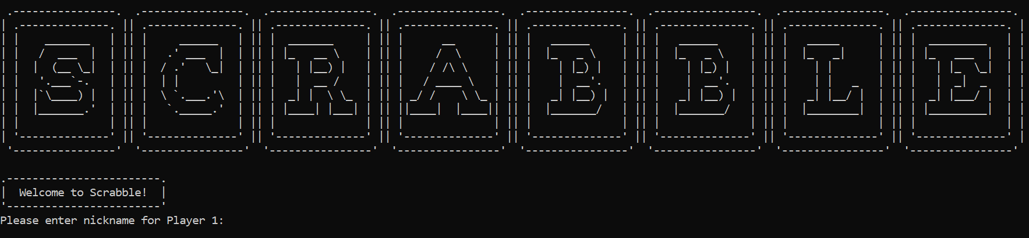
Showcase: Scrabble
We got our backend and basic classes working in a terminal version of Scrabble
Our design shifted slightly from class diagram - UI was more prominent
Short main.py file to power the game - uses functions of all the classes
Notes:
We focused on terminal version
UI was pushed more to the forefront, it is the gateway for the main program to interact with the other classes
Our powering program main.py was very short in the end

Slide 11
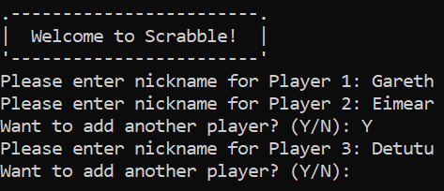
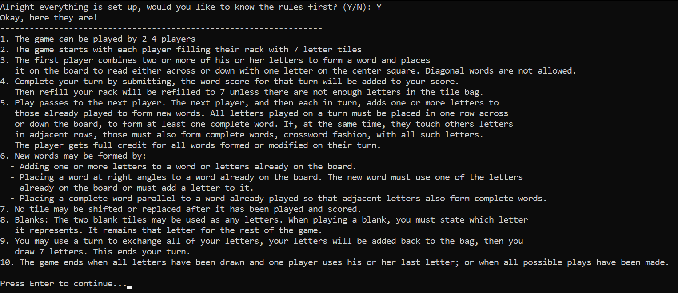
Starting the game
Players get option to see rules before they start
The welcome screen takes in players names. When the game starts it will set up a player object and tile rack for each name.
Notes:
At the start of the game the UI class will gather the names of the players from the terminal.
When the game starts, player objects, their racks and the board object is created.
Players can see the rules displayed by our rulebook class before the game starts

Slide 12
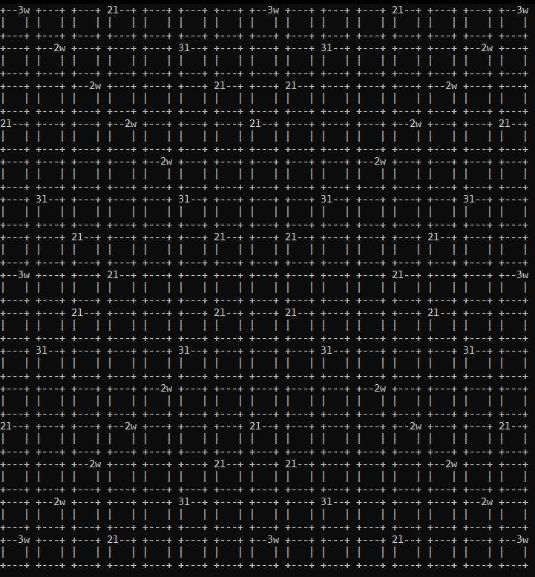
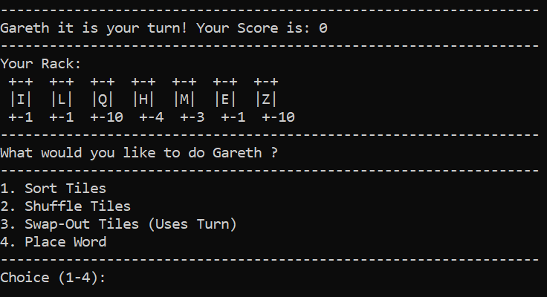

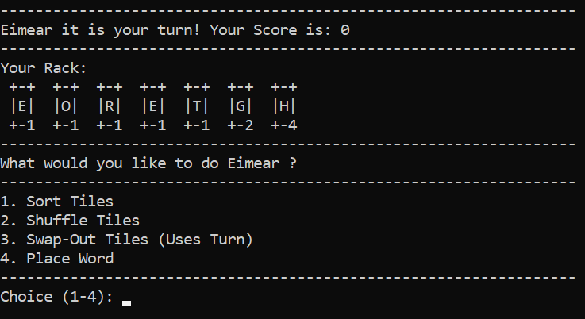


The game begins
Now a basic looping mechanism takes control
Each Player is shown the board and their rack and given options of what to do
Notes:
Then a very simple loop takes over in our runner file
Each player is shown their rack and options to choose from, each option corresponds to a method in our rack class

Slide 13
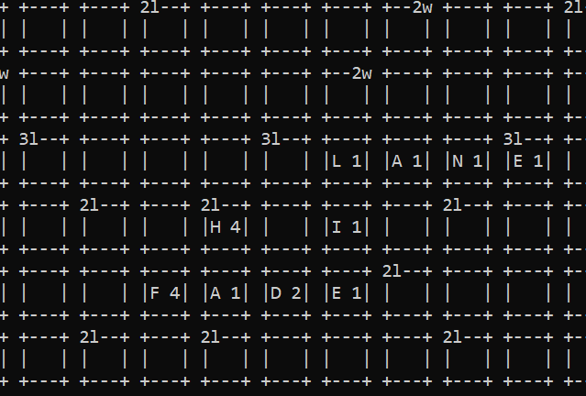
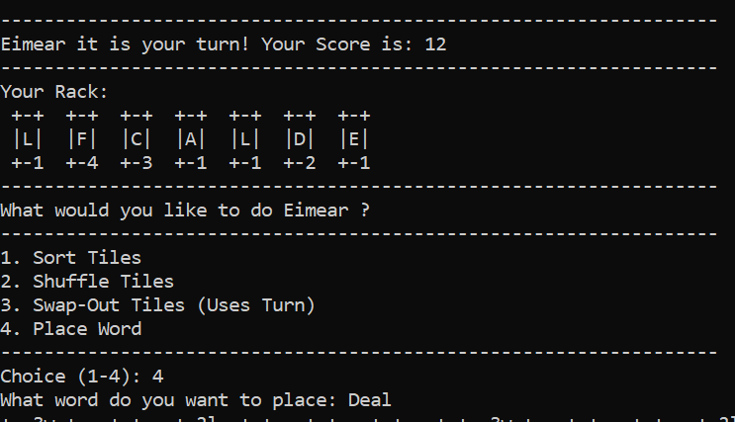
Play continues until bag is empty, the board filling up, each players score increasing
We used an API to check if the words were from the dictionary

Slide 14
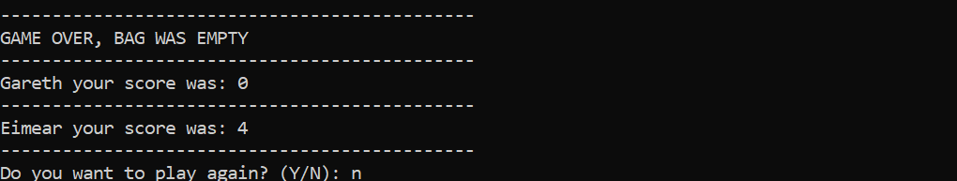
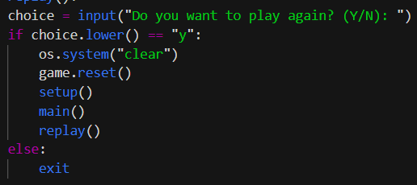
When the game is over, an option to replay is presented, this is easily achieved using our OO model.
There are still some unfinished parts and features, but we are very happy to be able to see how our classes and methods interact and work together through this simple terminal game

Slide 15
Thanks for Listening
Any Questions?

